Slide 1
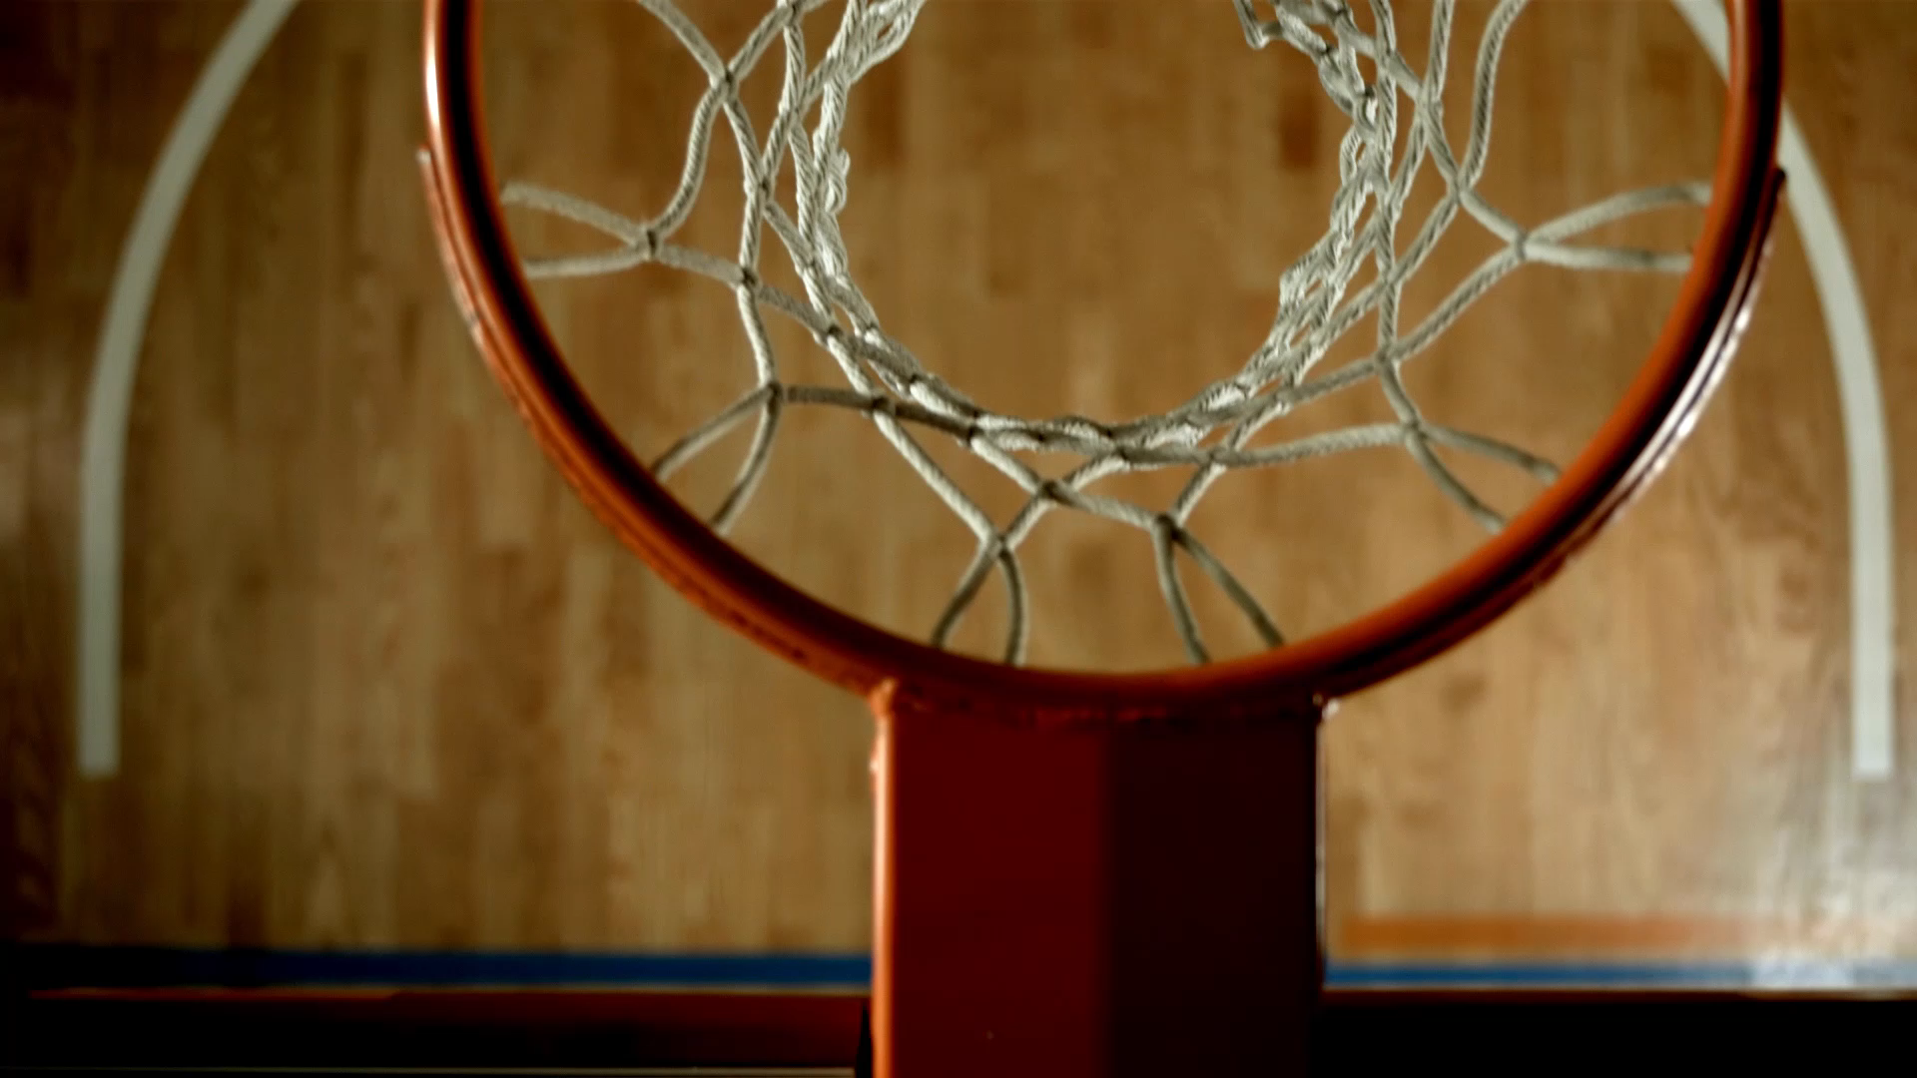
NBA Shot Analysis
Comparing 2008-09 to 2018-19 Season
By Alvin Lucero

Slide 2
Motivation & Questions
How has player shot selection changed compared to 10 years ago?
Have shooting percentages gotten better?
How many more three-point shots are attempted compared to 10+ years ago?
Interest in basketball as I have been playing it for over 10 years

Slide 3
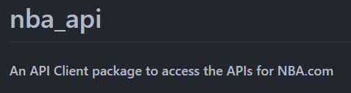

Data Sources
API calls from NBA API
stats.nba.com
Kaggle dataset

Slide 4
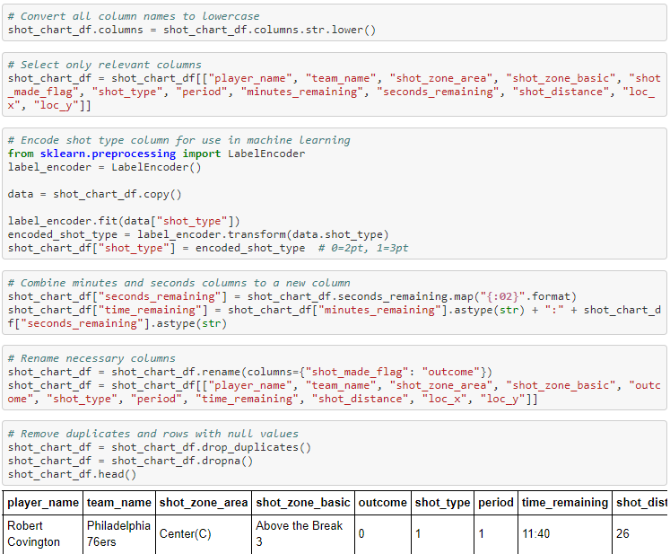
Data Preparation
Data Preparation Steps:
Converting all columns to lowercase
Selecting only relevant columns
Using label encoder from sklearn to encode shot type (needed for machine learning)
Renaming columns to more descriptive names
Dropping any duplicates or rows with Null values
All other datasets were cleaned in a similar fashion

Slide 5
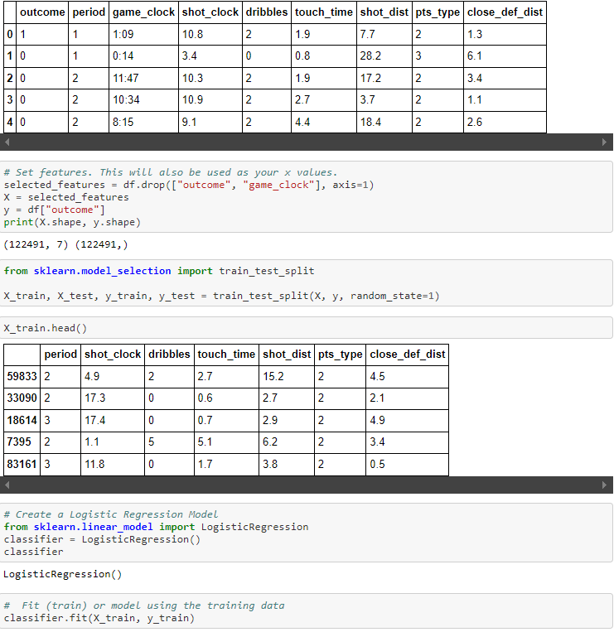
Model Training
Using machine learning to predict whether or not a shot will go in
Classification Machine Learning was chosen as there are only two outcomes:
Shot is made
Shot is missed
Selected features for X:
Period
Shot clock
Dribbles
Touch time
Shot distance
Points type
Closest defender distance

Slide 6
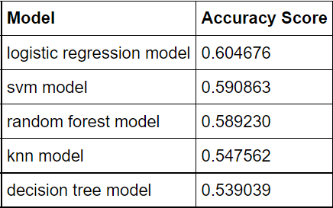
Model Selection
Other models under the Classification category was also built
model.score() to determine the accuracy of each model
The Logistic Regression Model was chosen as it had the highest accuracy score

Slide 7
Findings and Visualisations
https://nba-shot-analysis-al001.herokuapp.com/

Slide 8
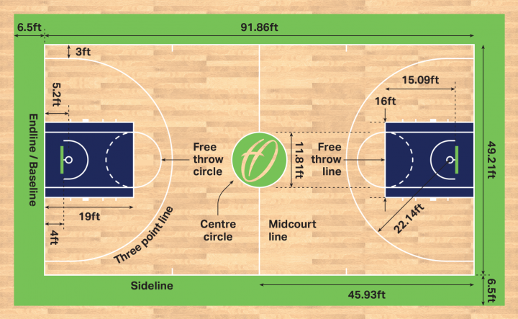
Basketball Basics
10 players on the court, 5 on each team
A team is usually composed of 2 guards, 2 forwards and 1 centre
Objective: Score the ball in the hoop at the end of the court. The team with the most points at the end wins
Teams advance the ball by either dribbling or passing
When a shot is made, the amount of points awarded depends on where the shot came from:
3 points for shots beyond three-point line
2 points for anywhere in three-point arc
1 point for shots during free throws
A shot clock is used to keep the game flowing. Teams have 24 seconds when in possession of the ball to score

Slide 9
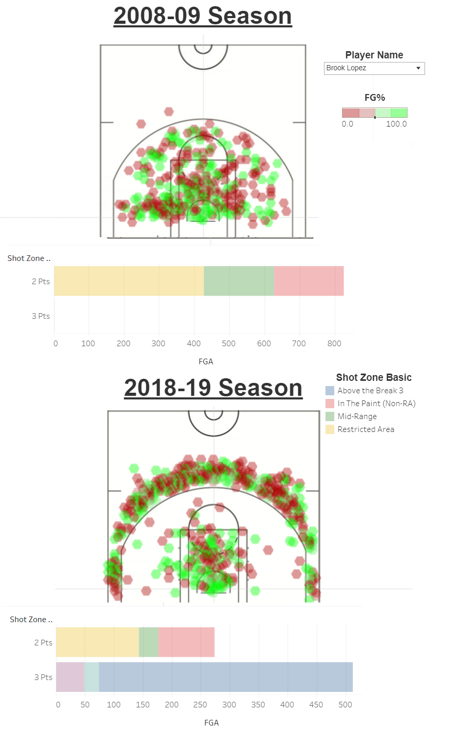
Player Shot Comparison
This chart maps out the positions on the court where players have made a shot
Comparing the shot locations made during the 2008-09 and 2018-19 season
Findings:
Players are transitioning more towards 3 point shots
Notable Player Comparisons: Brook Lopez, Marc Gasol, Kevin Love, Al Horford and Trevor Ariza
Brook Lopez only had 2 three-point attempts during 2008 season, compared to over 500 attempts during 2018 season
Many players who have transitioned to shooting more 3 point shots are Centres (4/5 of the players listed above play Centre)

Slide 10
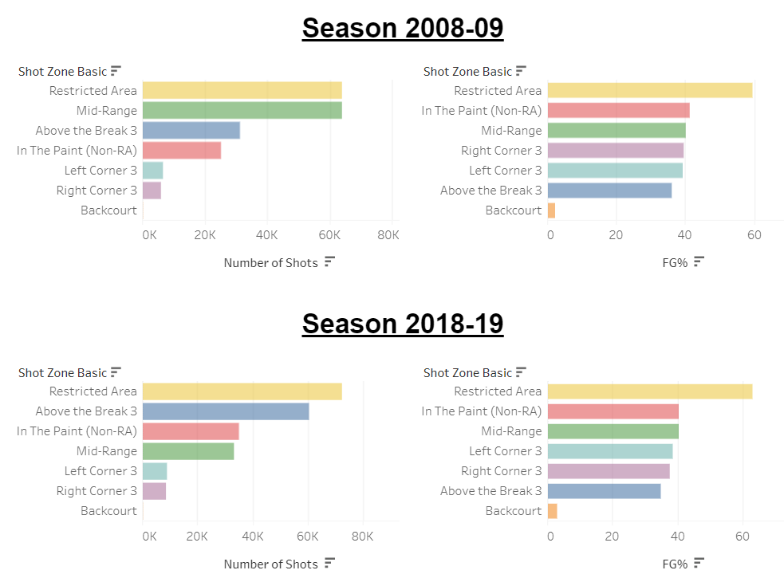
League Shot Comparison
Contrast between the number of shots taken in the mid-range and above the break 3 between seasons
Mid-range shots halve from 60 000+ attempts in 2008 to around 30 000 attempts in 2018
Above the break 3’s follow inversely, with 30 000 attempts in 2008 to 60 000+ attempts in 2018
Field goal percentages remain similar when comparing the two seasons
Note that above the break 3’s FG% drops by ~1% despite the amount of attempts doubling

Slide 11
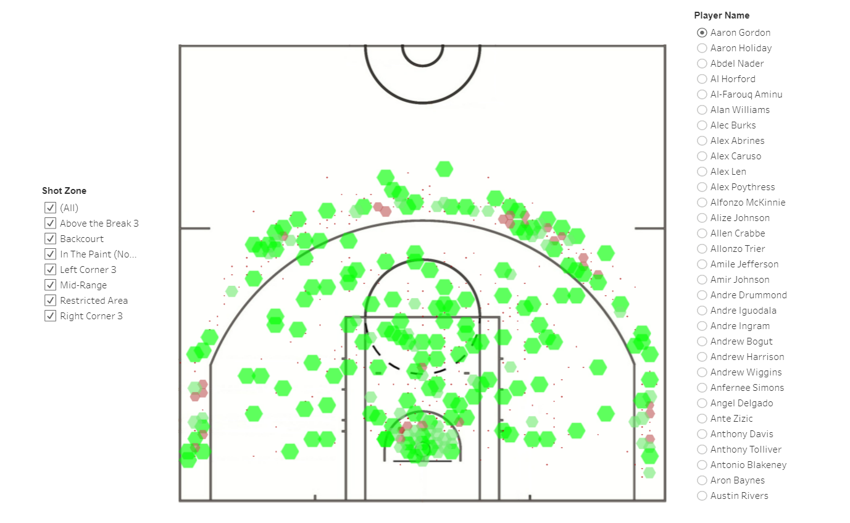
Player Shot Chart
An interactive chart showing the locations of shots taken by a player during the 2018-19 season
Size and colour of markings are scaled by the FG% of the player at that location
Chart is filterable by shot zone and player name

Slide 12
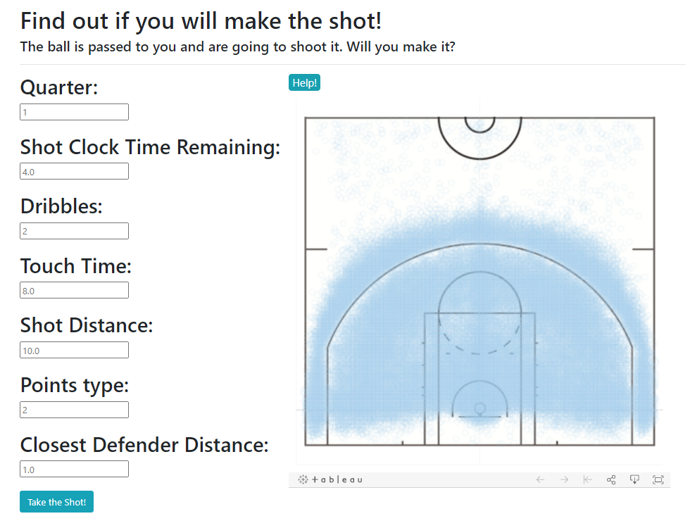
Take The Shot! (ML)
Machine Learning model used to predict if a shot will go in or not
Takes user inputs and inputs it into the Logistic Regression Model created in order to predict an outcome
Users can use the chart on the right to help with shot distances

Slide 13
Summary
Players now tend to favour 3-point shots over mid-range shots
Shooting percentages haven’t improved over the years
Why do teams shoot more 3-point shots?
The team with more points at the end wins
The league average for 3-point shots is ~37% or 1.11 points per shot
For a 2-point shot to be worth 1.11 points per shot, players would have to shoot ~55% from 2-points range, which they currently do not

Slide 14
Future Use Cases
Players can use these findings to fine tune their game in areas that are relevant to todays game (3-point shooting)
Coaches can choose to focus more on 3-point shots on offensive and defensive strategies

